Slide 1
Applying Population Ecology: The Human Population
G. Tyler Miller’s
Living in the Environment
14th Edition
Chapter 10
(Pages 176-192)

Slide 2
Key Concepts
Factors affecting human population size
Human population problems
Managing population growth

Slide 3


CASE STUDY: Thailand
1971 Policy to reduce population
- Before: 3.2% GR, avg. family: 6.4 children
- After (1986): 1.6% GR, avg. family: 1.7 children
Programs initiated
  Government supported family planning
  High literacy rate among women
  Increased economic role & advances for women’s rights
  Better health care for women & children
Population and Community Development Association (PCDA)
  Non profit organization
  Helped government by supporting programs
  Handed out contraceptives at festivals, movies, traffic jams
  Developed ads & witty songs

Slide 4
Factors Affecting Human Population Size
OBJ 10.1
Population change equation
Population
Change
=
(Births + Immigration) – (Deaths + Emigration)
Crude birth rate (CBR)
  - # live births per 1000 people in a population in a given year
Crude death rate (CDR)
- - # live deaths per 1000 people in a population in a given year
Refer to Figure 10-3, p. 177

Slide 5
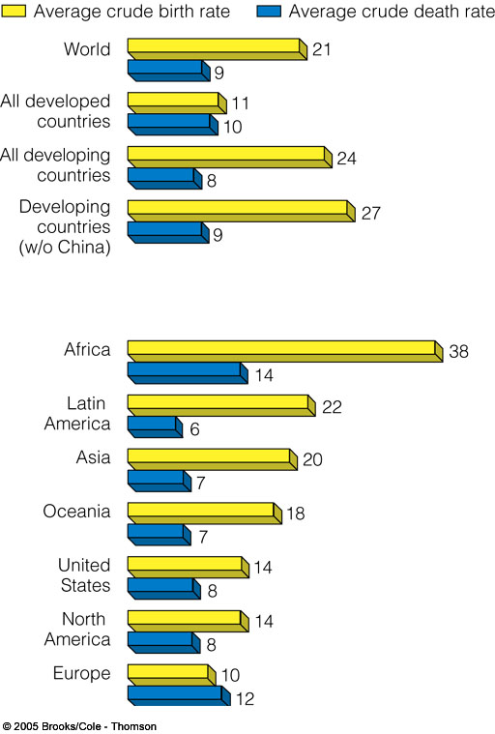
Average CBR and CDR

Slide 6
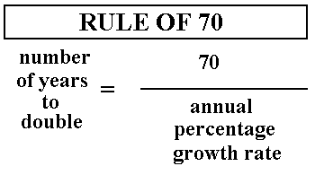
Describing Population Changes
OBJ 10.3
Doubling Times
- time (years) for a pop. Growing at a specified rate to double in size
“Rule of 70”
- - EX: 2004 world’s pop. growth rate 1.2%
doubling time = 70/1.2= 56 years

Slide 7
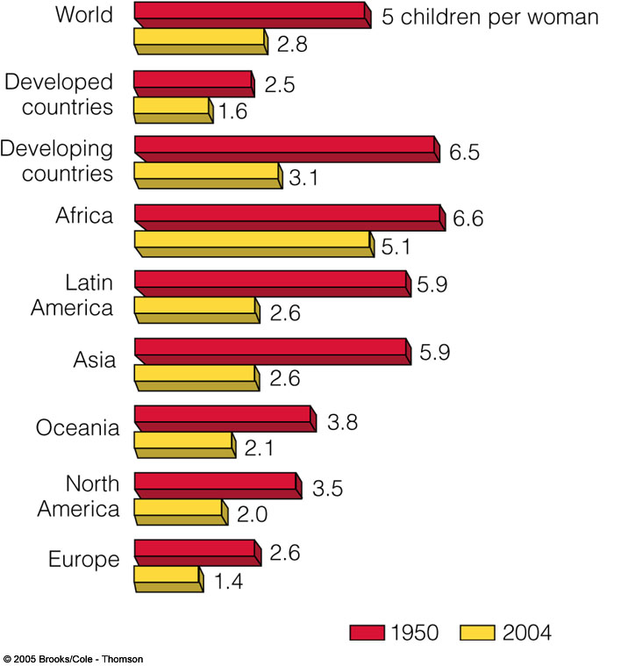
GLOBAL FERTILITY
OBJ 10.4
Fertility
  - # of births that occur to an individual woman or in an pop.
Replacement-level Fertility
  - # of children a couple must bear to replace themselves
Total Fertility Rate (TFR)
- average # of children a woman may typically have during her reproductive years

Slide 8
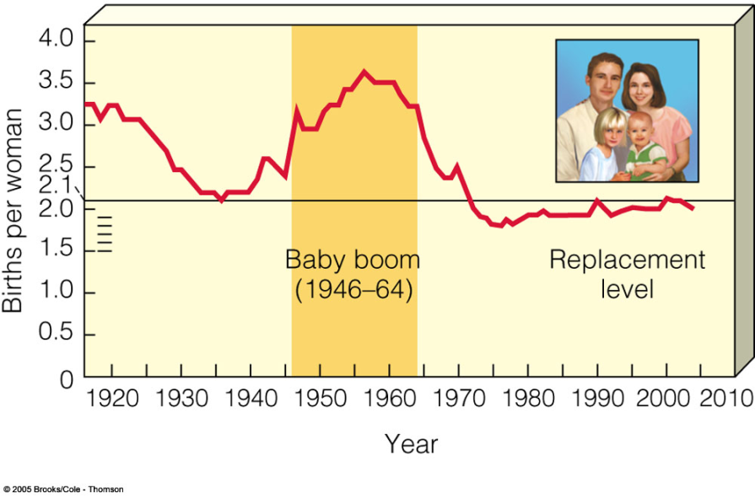
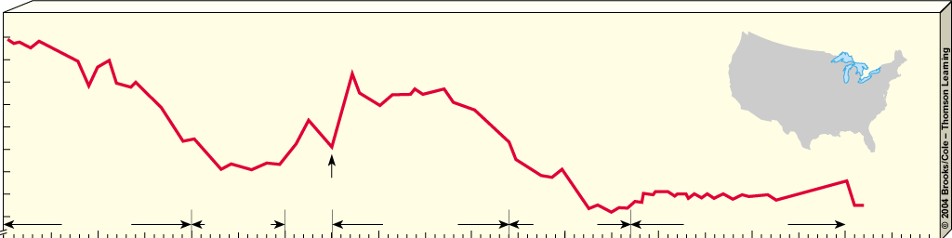
UPS & DOWNS: US Fertility & Birth Rates
76 mil (1900) to 294 mil (2004)
BIRTH RATES IN THE US
32
30
28
26
24
22
20
18
End of World War II
16
Demographic
transition
14
Depression
Baby boom
Baby bust
Echo baby boom
0
1910
1920
1930
1940
1950
1960
1970
1980
1990
2000
2010
Year

Slide 9
Factors Affecting Birth Rates and Total Fertility Rates
Children in Labor Force
Cost of raising and educating children
Availability of pension systems
Urbanization
Education and employment for women
Infant mortality rate
Average marrying age
Abortion
Availability of birth control

Slide 10
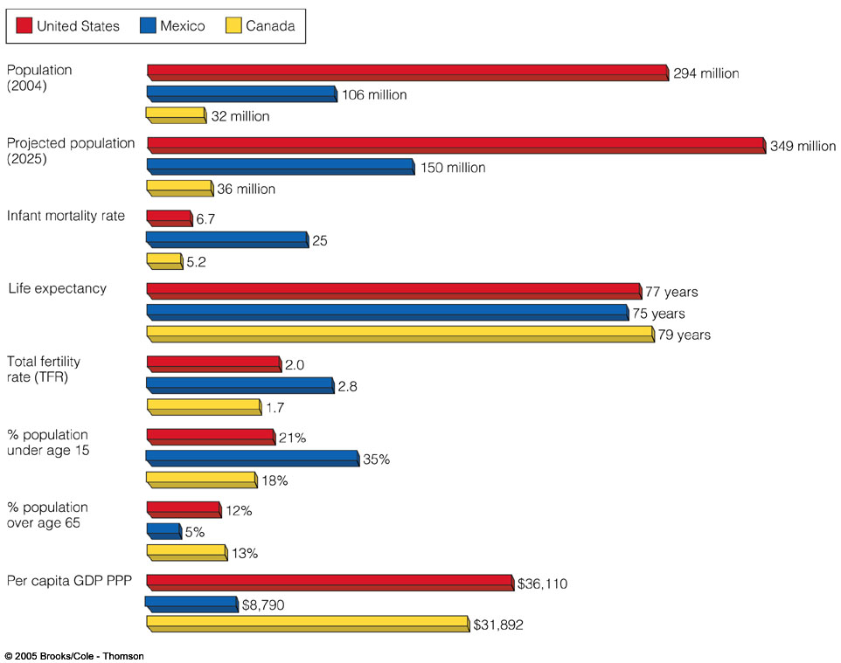
Comparison of Demographic Data

Slide 11
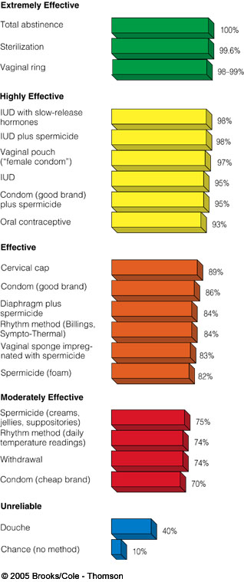
Typical Effectiveness of Birth Control Methods in US

Slide 12
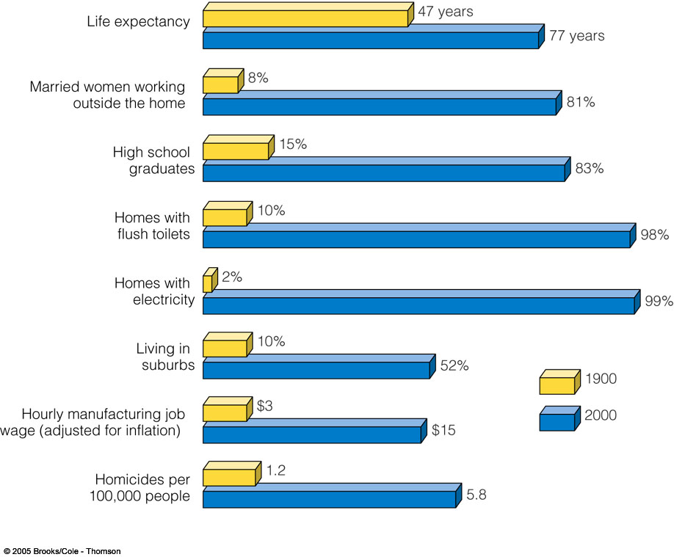
Major Changes in US 1900 & 2000
OBJ 10.5

Slide 13
Factors Affecting Death Rates
OBJ 10.7
Life expectancy
- avg. # years a newborn infant can expect to live
Infant mortality rate (IMR)
- # babies out of every 1000 born who die before their 1st birthday
GOOD NEWS | BAD NEWS
Global life expectancy increased from 48 years to 67 years (76 developed 65 developing) | Poorest least developed countries (African countries) life exp. 49 years
IMR dropped from 20 per 1000 live births to 7 in developed countries
IMR dropped from 118 per 1000 live births to 61 in developing countries

Slide 14
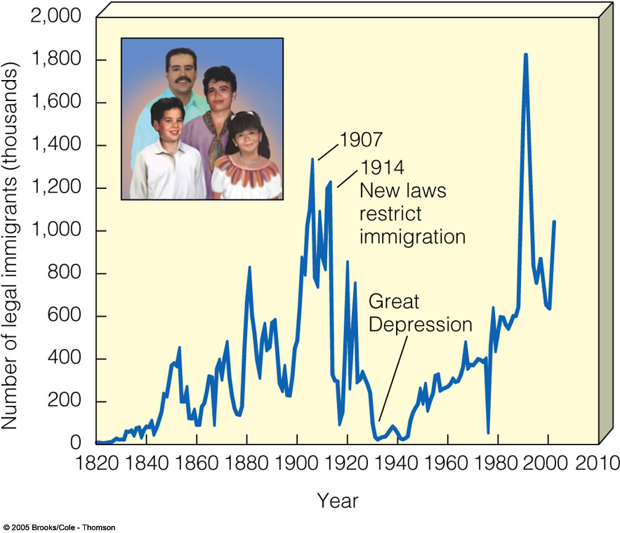
Immigration in the US
Countries encourage: Canada, Australia, US
Account for 1% for growth rate in developed countries
Accounts for 41% of country’s annual growth rate
1820-1960 most were from Europe
Since 1960 most are from Latin America (51%), Asia (30%), Europe (13%)
Largest minority group are Latinos
Concern: illegal immigration

Slide 15
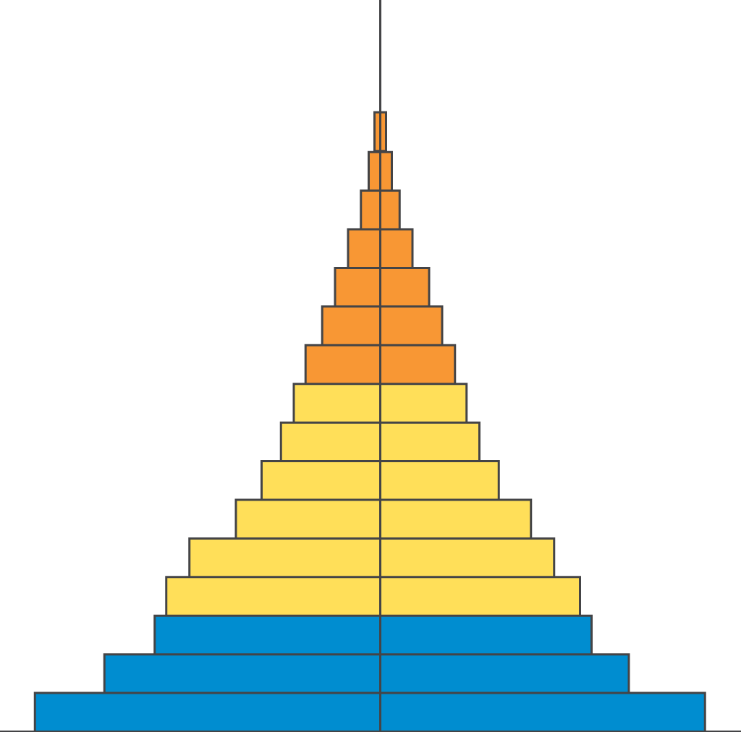
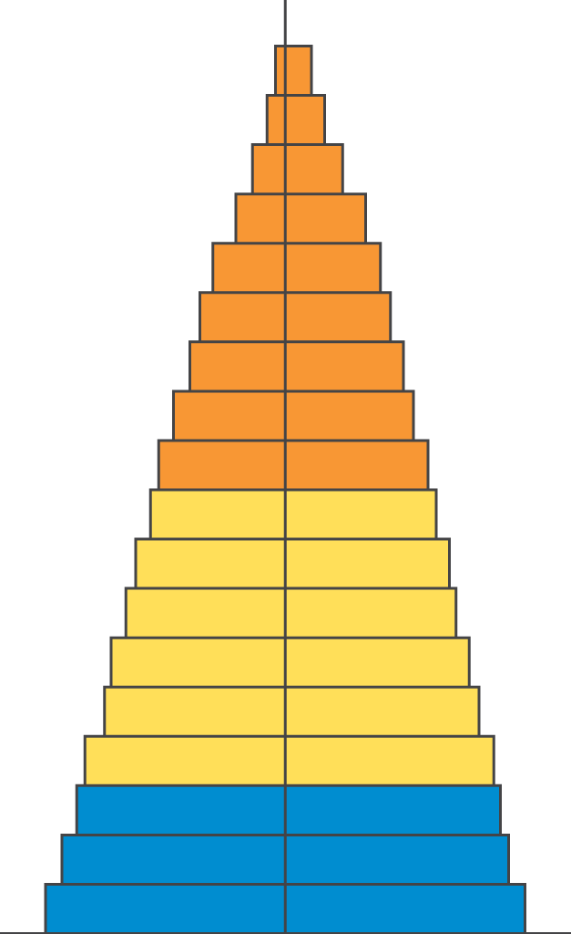
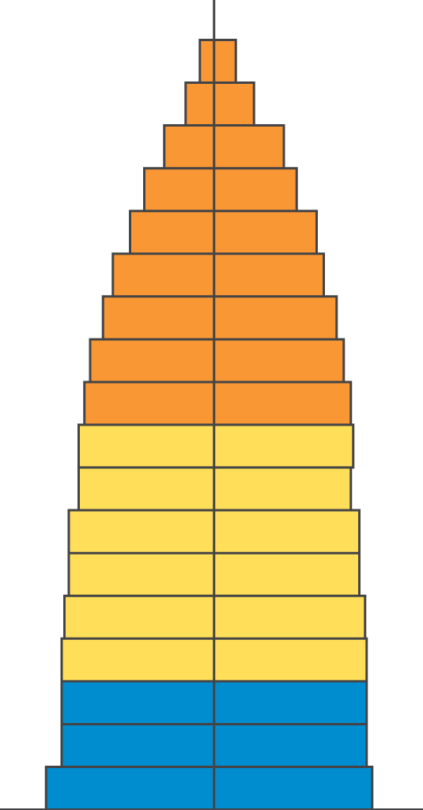
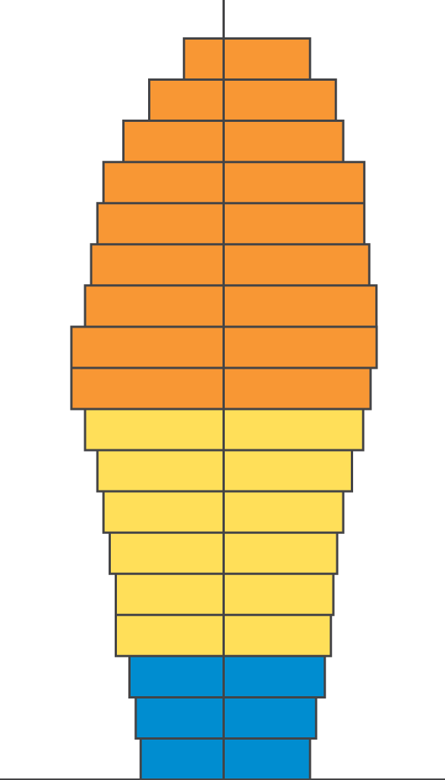
Population Age Structure
OBJ 10.9
Male
Female
Rapid Growth
Guatemala
Nigeria
Saudi Arabia
Slow Growth
United States
Australia
Canada
Zero Growth
Spain
Austria
Greece
Negative Growth
Germany
Bulgaria
Sweden
Ages 0-14
Ages 15-44
Ages 45-85+
Fig. 10-14 p. 184

Slide 16
Solutions: Influencing
Population Size
OBJ 10.11
Migration
Environmental refugees
Reducing births
Family planning
Empowerment of women
Economic rewards and penalties

Slide 17
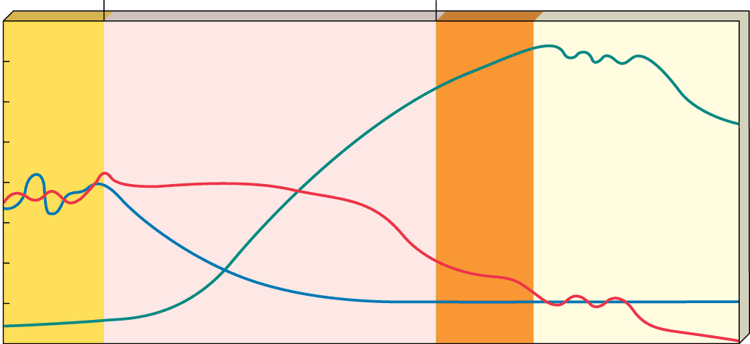
The Demographic Transition
OBJ 10.12,13
Fig. 10-20 p. 189
Stage 1
Preindustrial
Stage 2
Transindustrial
Stage 3
Industrial
Stage 4
Postindustrial
80
High
70
60
Birth rate
50
Birth rate and death rate
(number per 1,000 per year)
40
Relative population size
30
Death rate
20
10
Total population
0
Low
Low
growth rate
Increasing Growth
growth rate
Very high
growth rate
Decreasing
growth rate
Low
growth rate
Zero
growth rate
Negative
growth rate
Time

Slide 18
Case Study: Slowing Population Growth in India
Generally disappointing results:
Poor planning
Bureaucratic inefficiency
Low status of women
Extreme poverty
Lack of support

Slide 19
Case Study: Slowing Population Growth in China
Economic incentives
Free medical care
Preferential treatment
Locally administered
Very intrusive and coercive

Slide 20
Cutting Global Population Growth
Family planning
Improve health care
Elevate the status of women
Increase education
Involve men in parenting
Reduce poverty
Sustainability

